Slide 1
State of the State

Slide 2






Dramatically Improved Fiscal Position
Budget surpluses for six straight years
Rainy day fund maxed out @ $4.1 billion
Credit ratings upgrades by all four agencies, with Fitch and Moody's improving from "Stable" to "Good"
Pension debt paid down by $8.5B
Dramatically Improved Fiscal Position

Slide 3


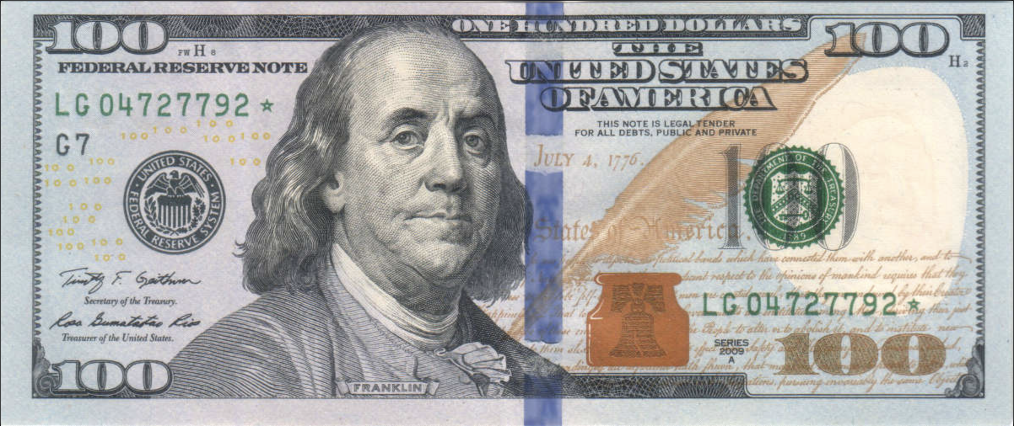

Nearly $1 Billion of Taxes Cut Over Last Two Years
Biggest middle- and working-class income tax cut since income tax established in 1991
Car tax cap to improve affordability
Eliminating income tax on
pensions and annuities
Dramatically Improved Fiscal Position

Slide 4


Economic Growth in Context – 2 Year CAGR
3.1 %
2.8 %
2.7 %
2.5 %
2.2 %
2.0 %
1.9%
1.6%
1.6%
+2.3%
CT
ME
USA
NJ
VT
RI
NH
MA
NY
Source: Bureau of Economic Analysis; 2021-2023 CAGR
Growth in Connecticut
Notes:
2 year CAGR is 15th in the country; prior to the pandemic we were 48th
CT
3.1%
19
ME
2.8%
20
MA
1.6%
44
NH
1.9%
39
NJ
2.5%
28
NY
1.6%
46
RI
2.0%
37
VT
2.2%
33
US
2.7%

Slide 5

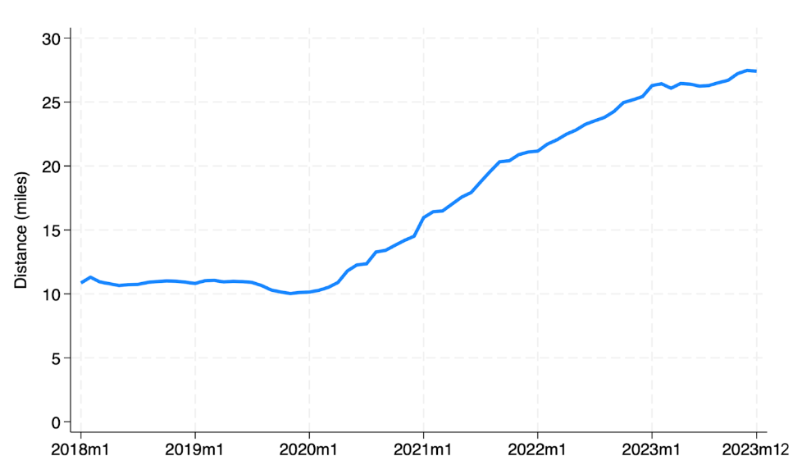
So What Changed?
This Did
Average Commute Distance
Growth in Connecticut
Source: https://gusto.com/company-news/americans-now-live-farther-from-their-employers

Slide 6

A Great Place To Live, Work, and Play
#2 Happiest
State in US
Most Diverse
State in NE
#4 Most Educated
State in US
#1 State for
College Readiness
*NiceRx study
*US Census Bureau
*WalletHub study
*US News & World Report
#2 Best
Community
College System
#2 Best K-12
Public Schools
in the US
#4 Best State
for Working
Mothers
#2 Most
Accessible
Healthcare in US
*WalletHub study
*WalletHub study
*WalletHub study
*Forbes
#1 State for
Personal &
Residential Safety
#1 State in
America for
Hiking
#2 State for
LGBTQ+ Business Climate Index
*WalletHub study
*Why This Place study
*Out Leadership report
A Great Place to Live, Work, and Play

Slide 7


Population Trends
2023 Population Growth
3rd
+8,470
straight year
of population
growth
Source: Census Bureau, Population Division
Growth in Connecticut

Slide 8


Population in Context - 3 Year Changes
+11,264
+1,802
RI
MA
NY
CT
NJ
-1,409
-31,534
Source: Census Bureau; Population Division
-631,104
Growth in Connecticut

Slide 9

Boosting Our
SMALL BUSINESSES

Slide 10

Small Business
Boost Fund
65.7%
$62.1
64%
57
%
%
million
awarded to MBWEs,
14% ahead of our goal
of towns & cities
received Boost loans
in loans awarded
through Oct '24
Small Business Boost Fund

Slide 11
Growth in New Business Startups
+10.2%
+8.1%
+7.0%
+6.5%
+4.4%
+3.4%
+2.7%
+2.3%
NJ
FL
CT
NY
MA
NC
TX
RI
VA
-1.0%
-3.0%
Source: US Census Bureau, change from Dec 2022 to Dec 2023
Growth in New Business Startups

Slide 12
Cultivating a Thriving
INNOVATION ECOSYSTEM

Slide 13

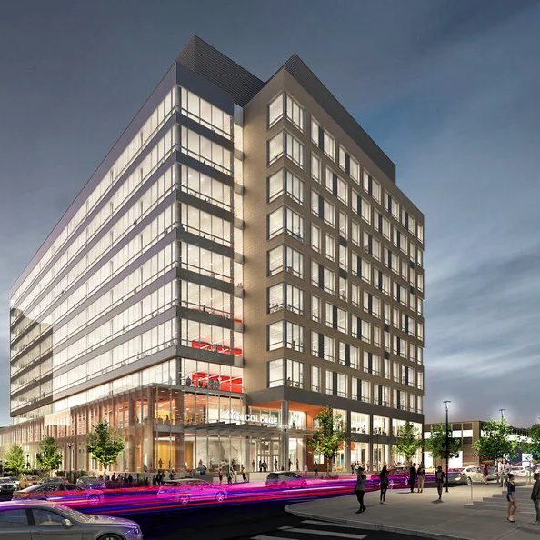
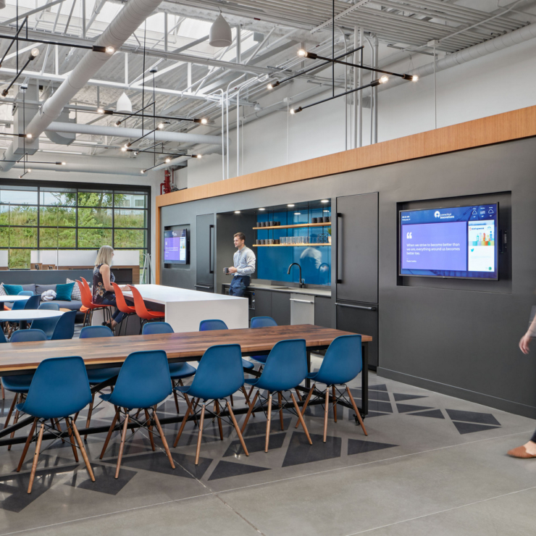
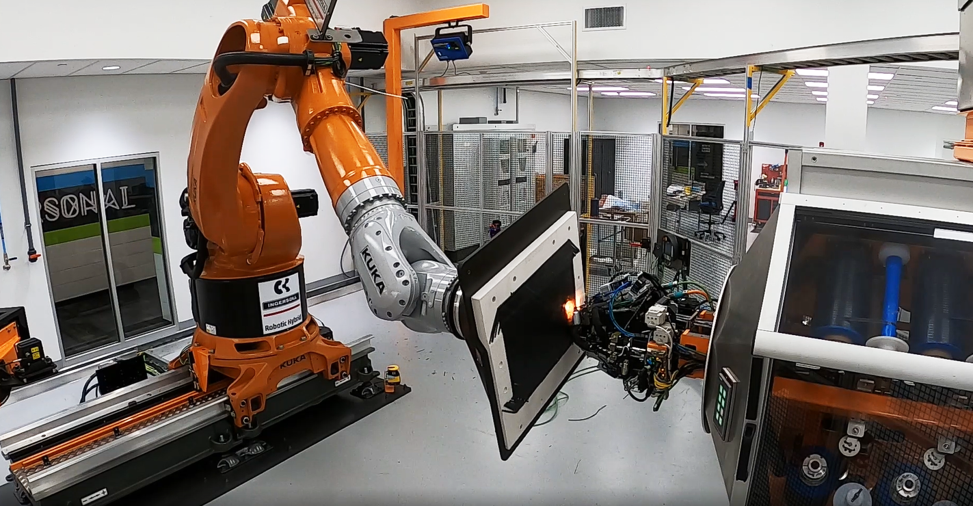


Cultivating a Thriving Innovation Ecosystem
Innovation
Clusters
Multiple place-making grants up to $100M over five years expected to create up to 15,000 jobs in high-growth industries
Investing and collaborating with tech startups
Supporting the
innovation economy
through support for mentorship, internships, technical assistance and access to capital
Cultivating a Thriving Innovation Ecosystem

Slide 14

A Natural Home For Innovation
#2
State for
Patents Granted
to individuals & orgs
#4
Most Innovative
Economy in the US
#4
in the US
for Employees with
Advanced Degrees
Cultivating a Thriving Innovation Ecosystem

Slide 15
MANUFACTURING
the World’s Most Complex Machines

Slide 16
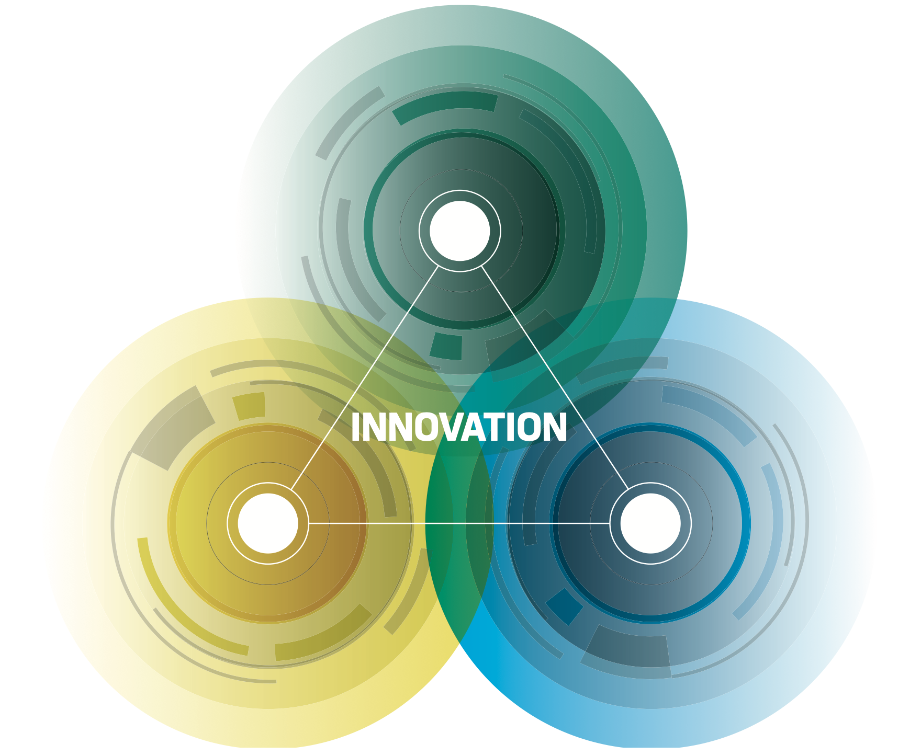
Driving Progress for CT Manufacturing
WORKFORCE - Growth
SUPPLY CHAIN
INDUSTRY - Expansion
Resiliency
Driving Progress for CT Manufacturing

Slide 17
Manufacturing Innovation
Fund (MIF)
$130M total funding
4,116 companies assisted
31,345 incumbent
workers trained by MIF funded programs
Manufacturing Economy

Slide 18
CT Leads the Region
Manufacturing is core to our economy
Source: BEA
Manufacturing Economy
Notes:
But what is unique to CT is we have a large exposure to a high energy sector in manufacturing and defense.
Higher than anyone else in the ISO.
And that exposure is growing while for others it is declining. Point our MA.

Slide 19
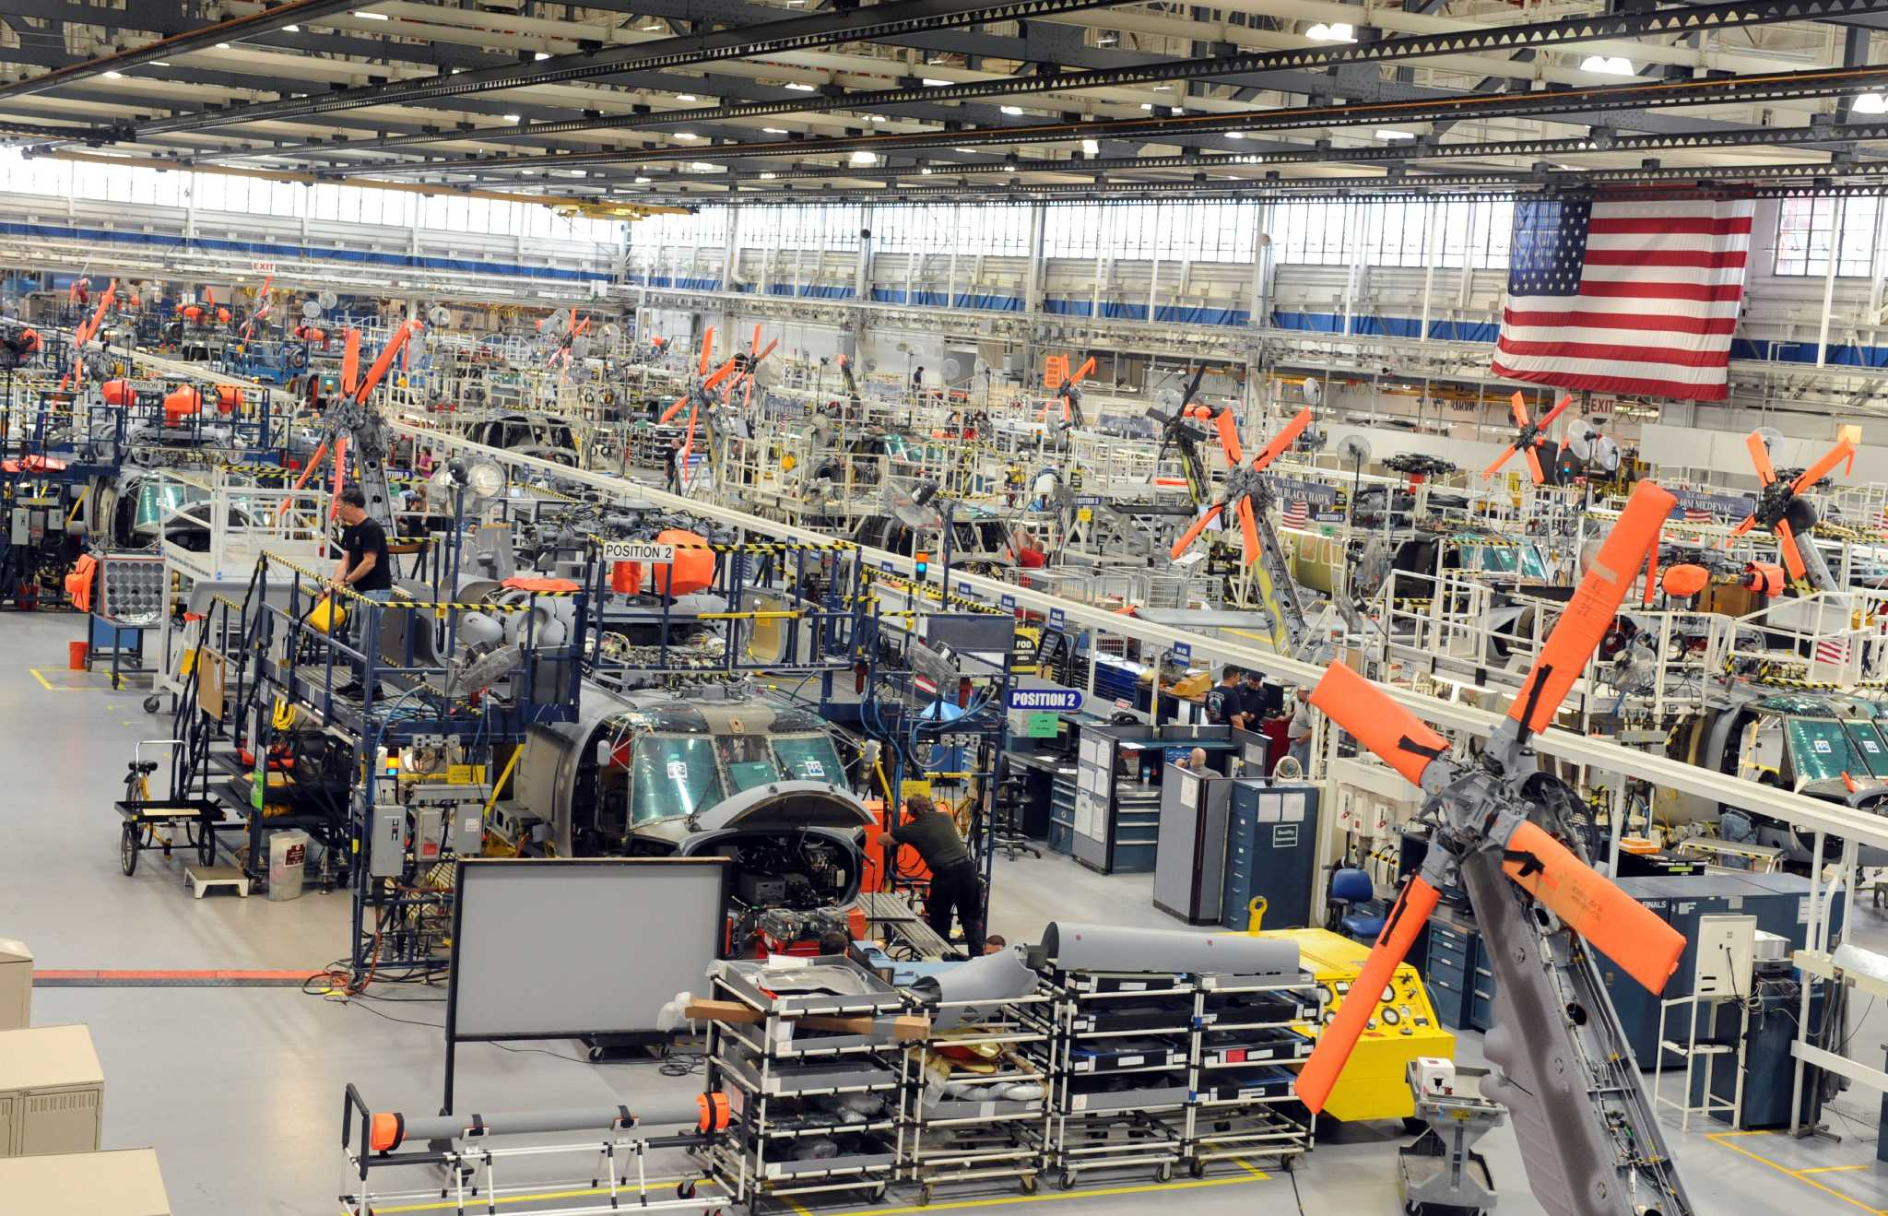
Manufacturing in the National Spotlight
#1
Aircraft Engine & Engine Parts Manufacturing
#2
Patents Granted to Individuals & Organizations
#3
Defense Spending Per Capita in US
#3
Most
Educated Workforce
#4
Productivity
of its
Employees
#5
Top Tier Companies with HQ in CT
#2
State for
Ship Building & Repairing
#1
College Readiness
Manufacturing Economy

Slide 20
How We Encourage
BUSINESS DEVELOPMENT

Slide 21





2023 Business Development
64
24
Business
Expansions
New
Investments
32
Team CT
Wins
8
12
HQ
Relocations
Foreign Direct
Investments
Business Development

Slide 22

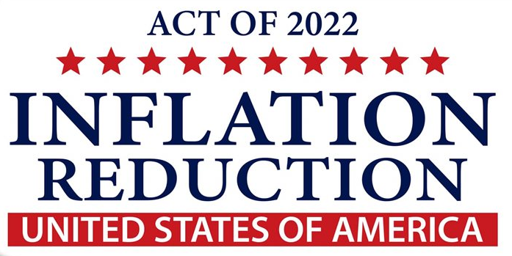

Federal Funds Opportunities
$1.2 trillion
to modernize transportation and aging infrastructure
$579 billion
in climate, energy and American manufacturing
$280 billion
reducing dependence on foreign semiconductors
The DECD Fed Funds team helps CT compete for strategically aligned federal awards via research, analysis, consortium building, outreach and more
Business Development
Notes:
Notes
The Infrastructure Investment and Jobs Act (IIJA), aka Bipartisan Infrastructure Law (BIL), was signed into law by President Biden on November 15, 2021. The law authorizes $1.2 trillion for transportation and infrastructure spending with $550 billion of that figure going toward "new" investments and programs.
State Focus: $284 billion in Surface-Transportation Networks and $266 billion in Enhancing Core Infrastructure.
On August 16, 2022, President Biden signed the Inflation Reduction Act (IRA) into law, marking one of the largest investments in the American economy, energy security, and climate that Congress has made in the nation's history.
State Focus: $370 billion in tax credits for solar panels, EVs and batteries and $214 billion in clean energy tax incentives and investments
The CHIPS and Science Act (CHIPS) is a U.S. federal statute enacted by the 117th United States Congress and signed into law by President Joe Biden on August 9, 2022.
State Focus: $39 billion in Manufacturing Incentives and $11 billion in R&D

Slide 23
Building the
WORKFORCE
of Today and Tomorrow

Slide 24
Filling Connecticut’s Job Vacancies
JOB OPENINGS RATE
Job openings rate continues to exceed pre-pandemic levels, giving us an opportunity
Investments in workforce development focus on high-growth and high-need industries, like manufacturing, healthcare, IT, construction, clean energy, and bioscience
Average
2019
2020
2021
2022
2023
US
4.5%
4.3%
6.4%
6.8%
5.6%
CT
3.7%
3.6%
5.6%
6.8%
5.1%
Note: job openings as a percent of total jobs.
Source: Bureau of Labor Statistics, seasonally adjusted JOLTS data through July 2024.
Downloaded 10/07/2024
Workforce

Slide 25



Attracting a
World-class Workforce
Workforce Development
$145M invested in multiple programs while Governor’s Workforce Council overseeing & coordinating statewide strategy & investment
Public Education
Top 2 K-12 and community college systems leads to CT being #1 state for college readiness and #4 for growth in young professionals
Attracting a World-class Workforce

Slide 26
Shaping Vibrant & Equitable
COMMUNITIES

Slide 27
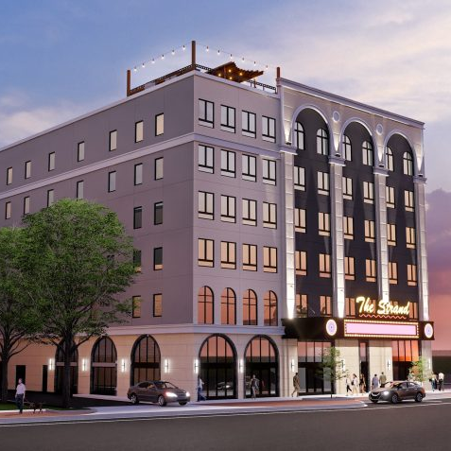
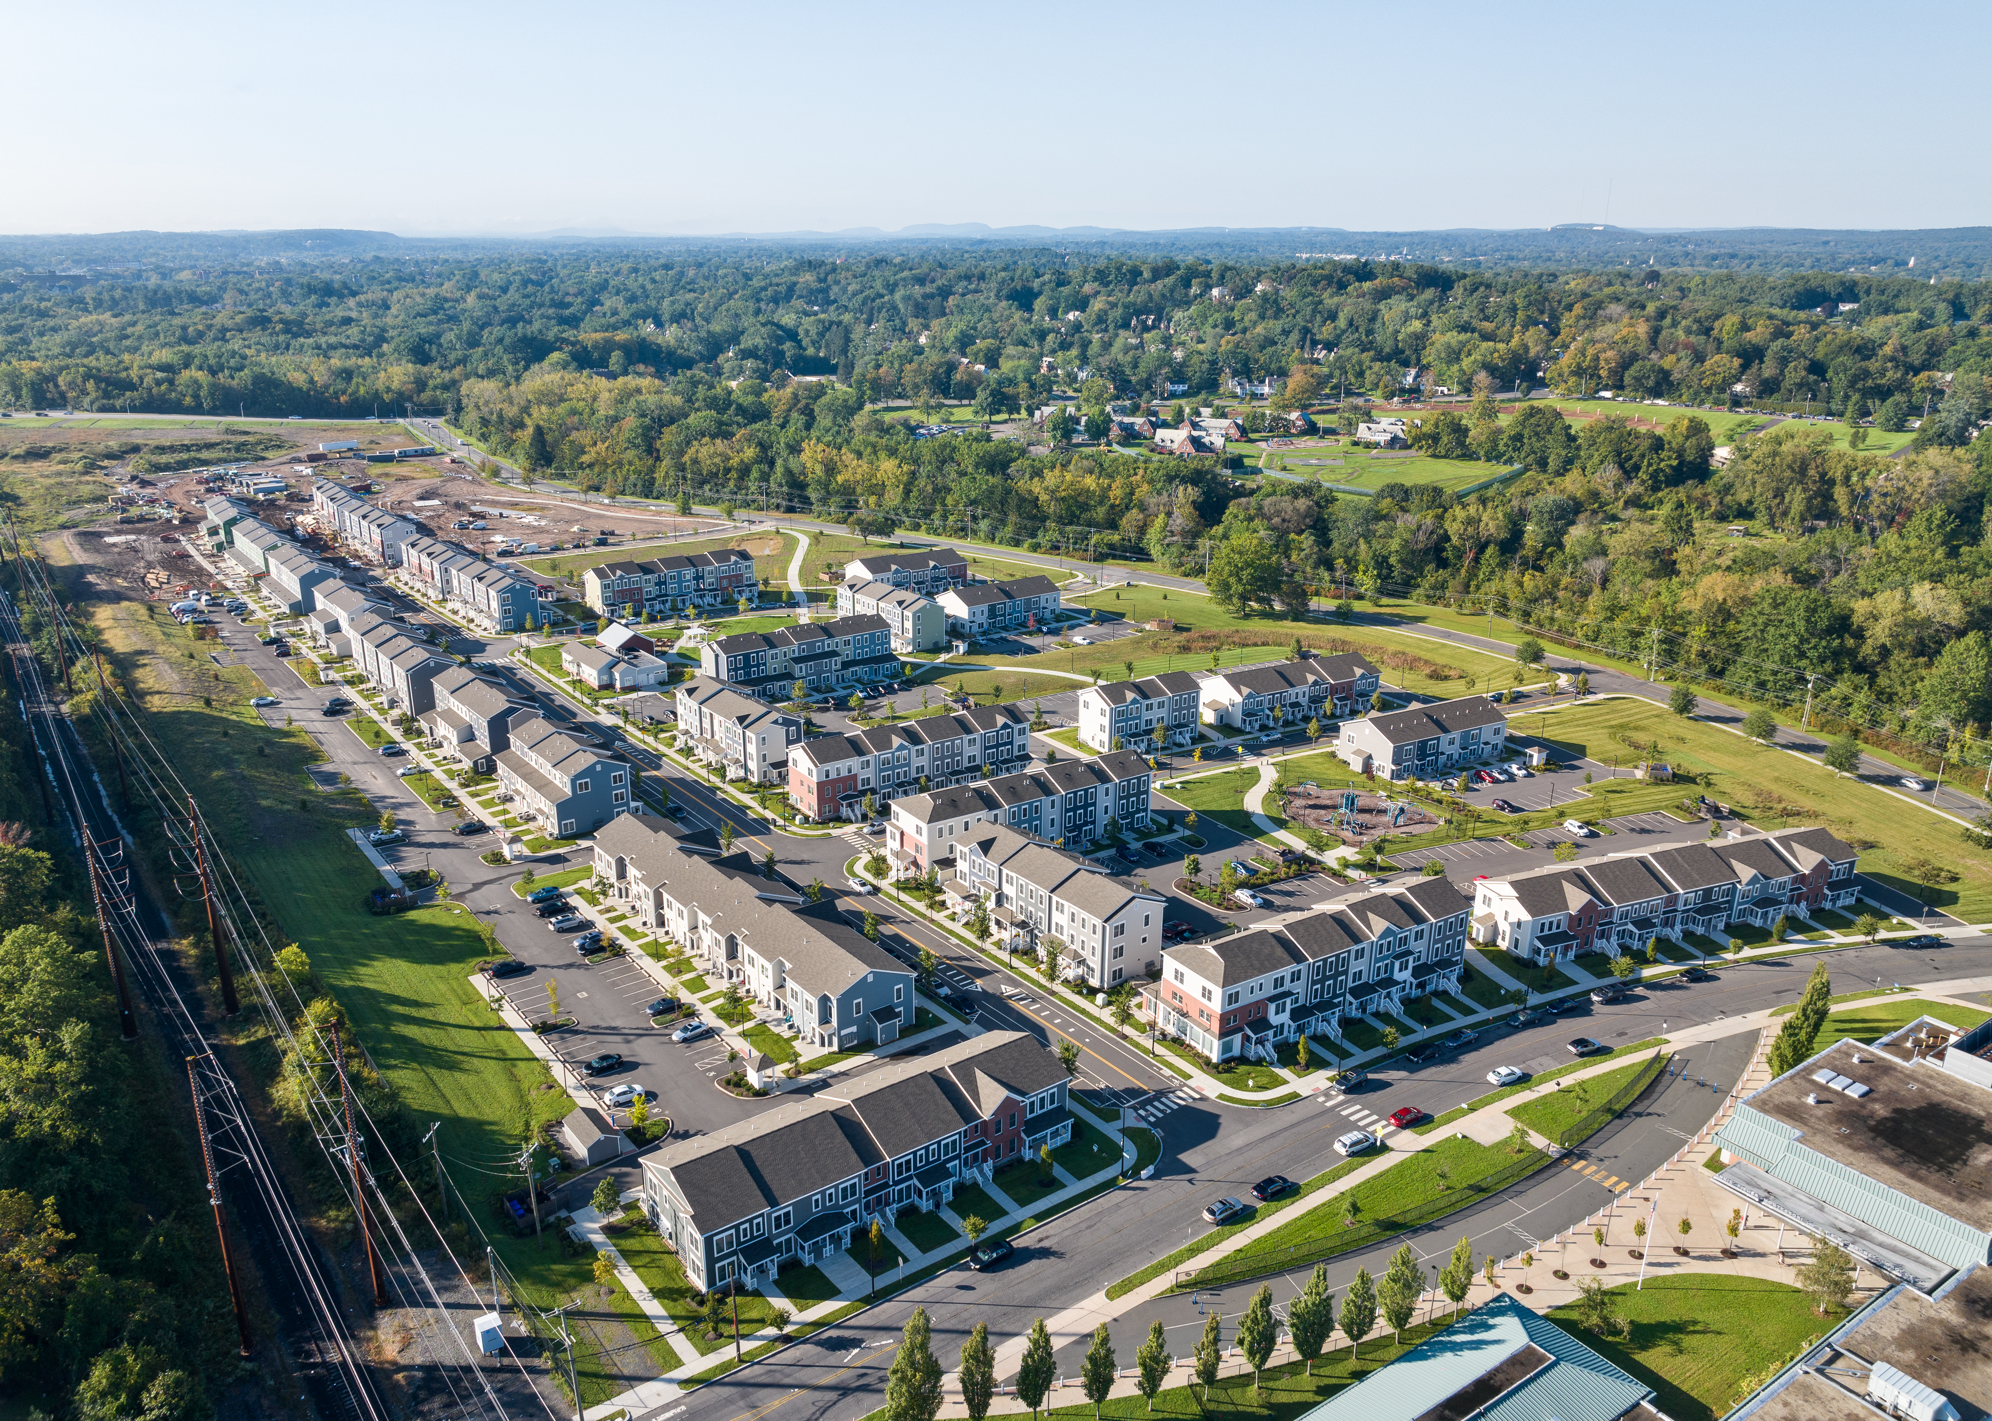
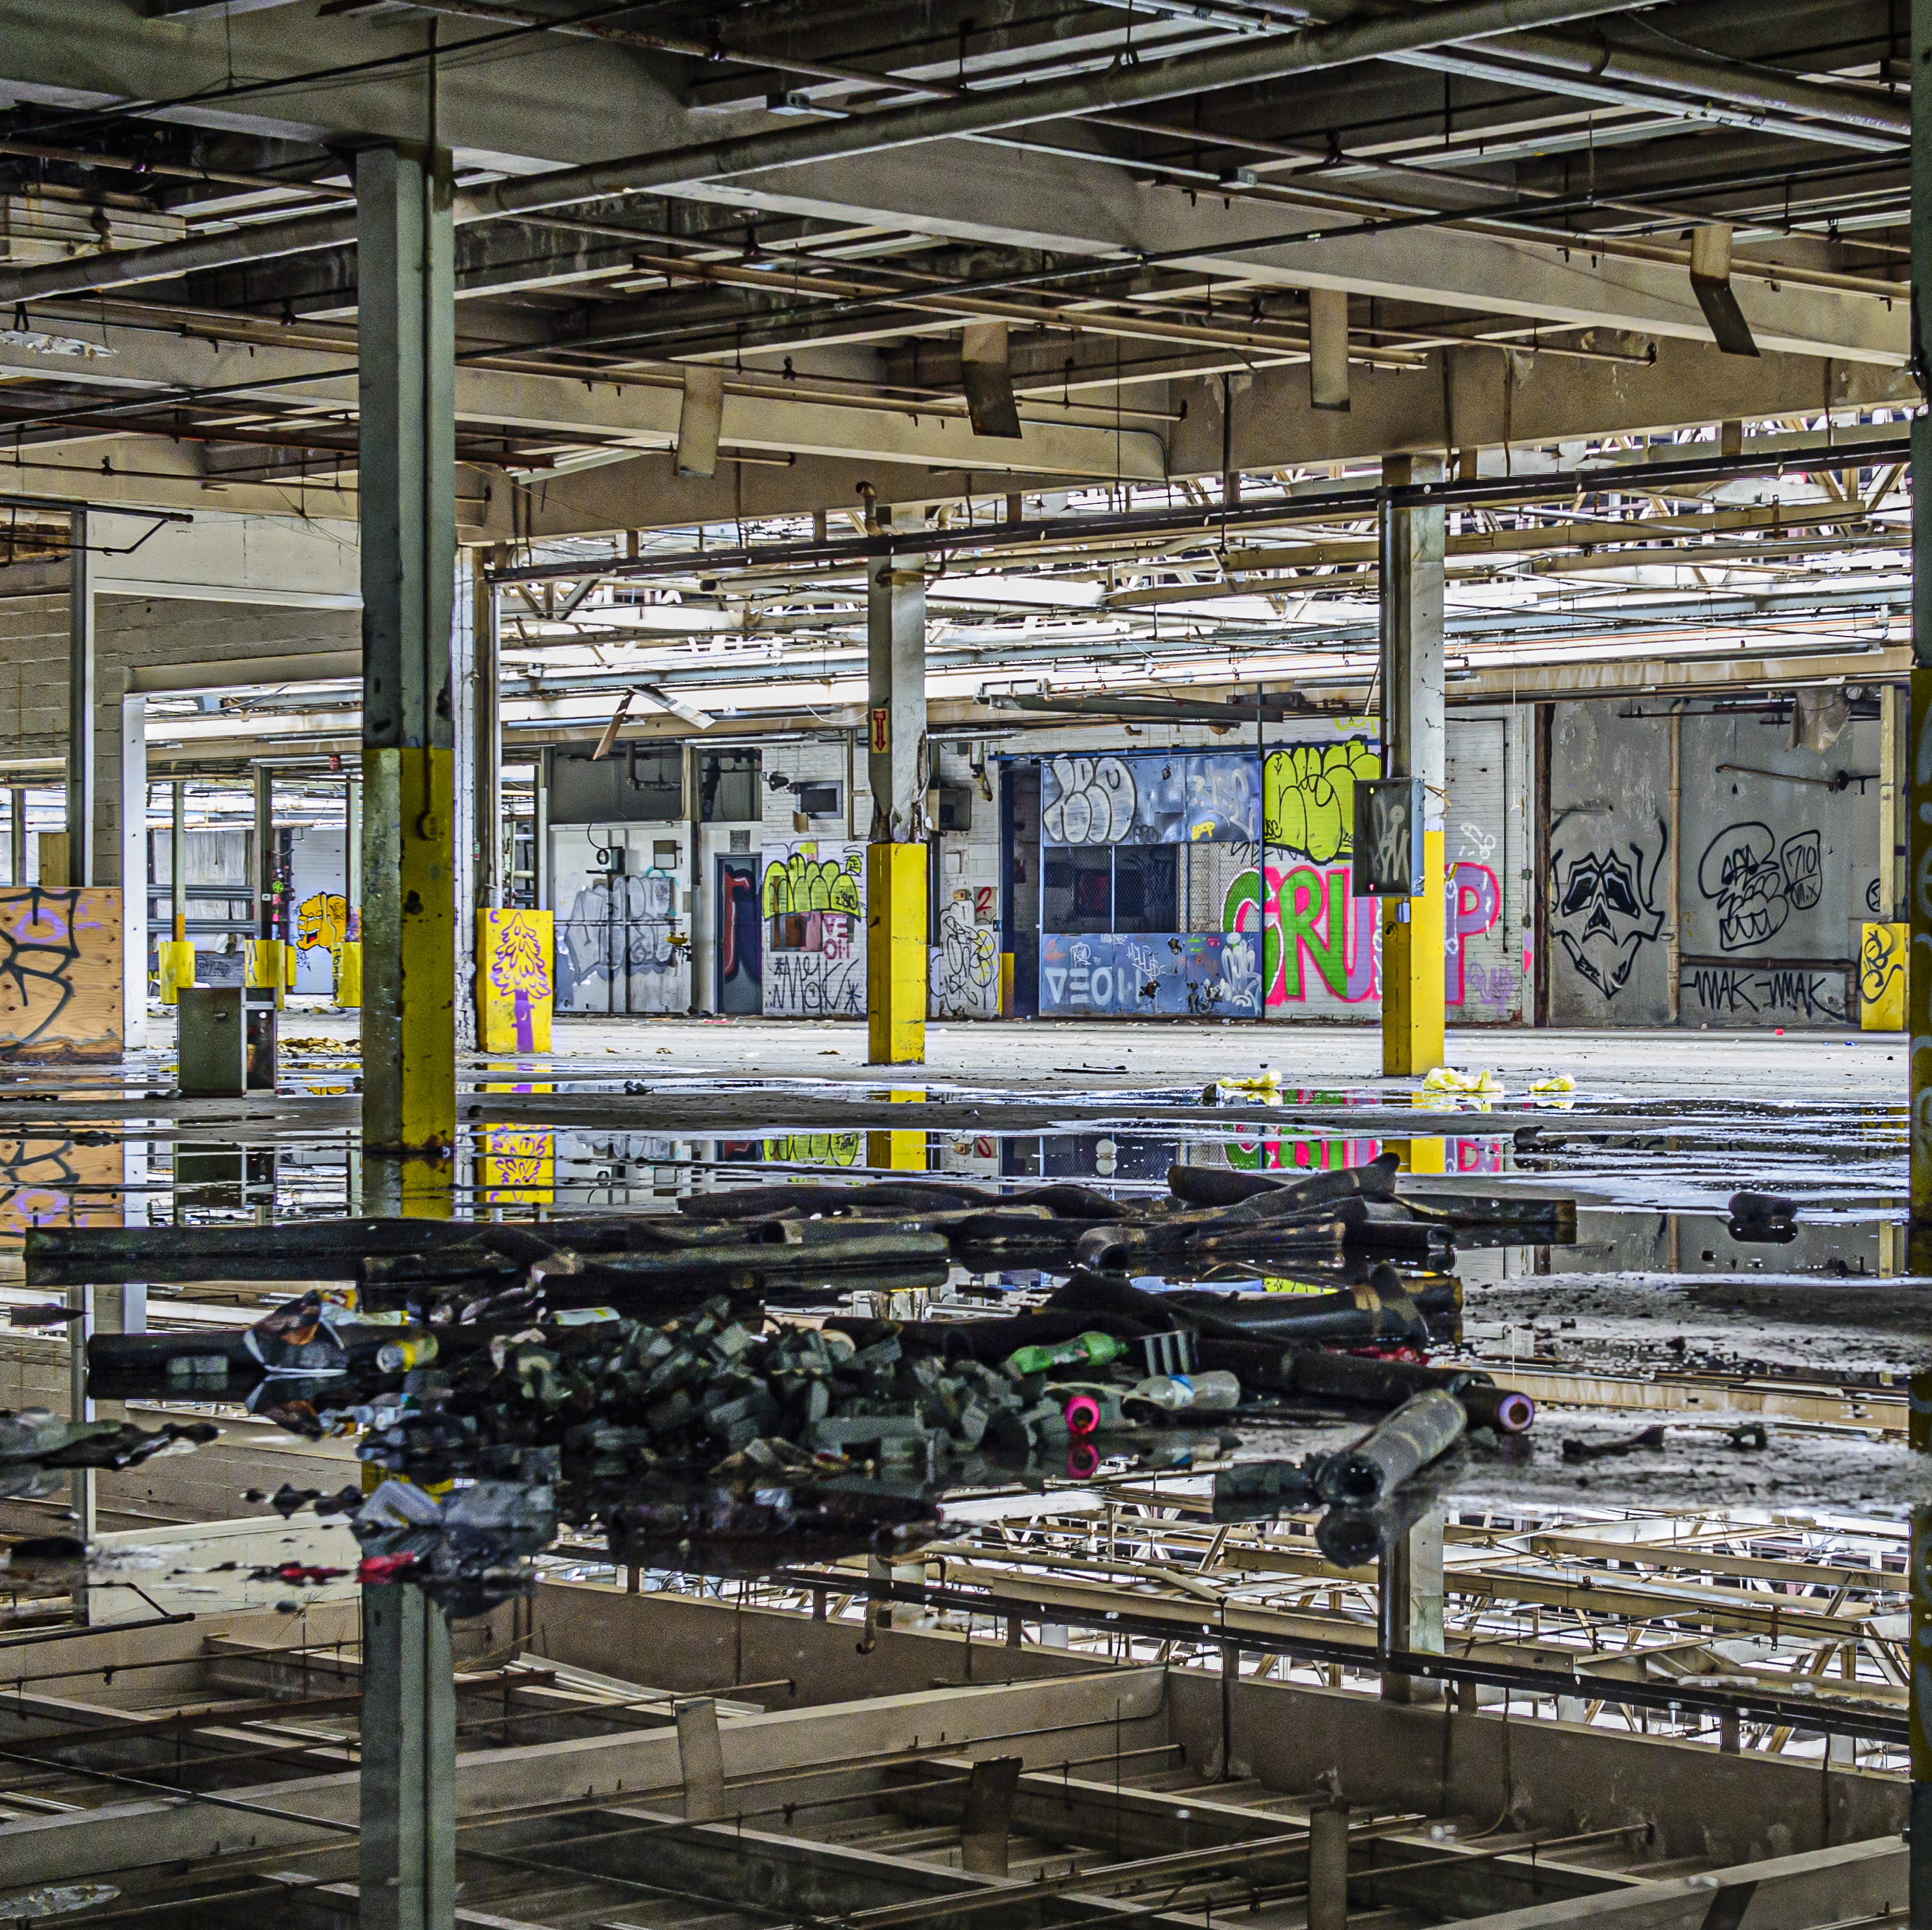
Nearly $2 Billion Invested in our Communities
Community
Investment
Fund
Housing
Brownfields
$875 million
for underserved communities
$800 million
including
workforce housing
$300 million
for industrial cleanup
Notes: CIF: 5 year authorized amount; Housing: next 2 years authorized spending; Brownfields: 10 years previous investment plus next 2 years authorized.
Capital Projects Nearing $2 Billion

Slide 28
2023 Statewide Housing Development
7,394
46.6%
5,147
5,145
5,043
4,482
2023 Statewide Housing Development

Slide 29

Arts &
Museums
Marketing
& Branding
Tourism

Slide 30


